Slide 1
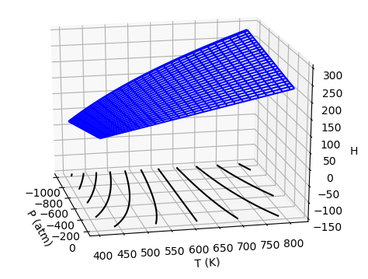
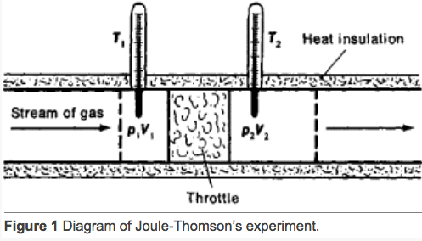


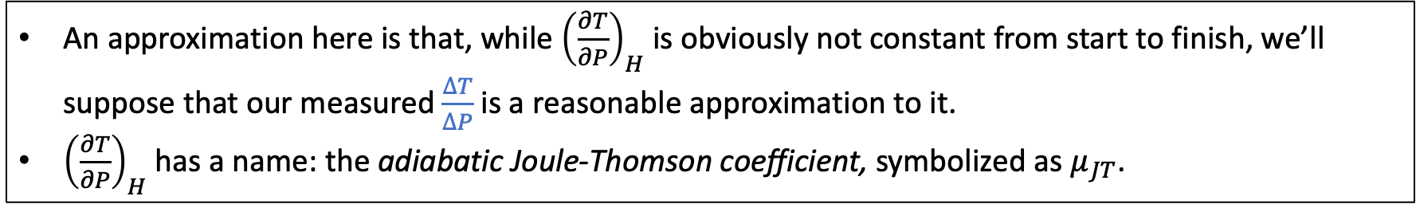
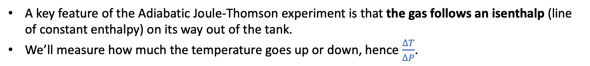
Today: The Adiabatic Joule-Thomson experiment
A key feature of the Adiabatic Joule-Thomson experiment is that the gas follows an isenthalp (line of constant enthalpy) on its way out of the tank.
We’ll measure how much the temperature goes up or down, hence $\frac{∆T}{∆P}$.
$$∆P$$
https://encyclopedia2.thefreedictionary.com/Joule-Thomson+Effect
$$∆T$$
An approximation here is that, while ${\left(\frac{∂T}{∂P}\right)}_{H}$ is obviously not constant from start to finish, we’ll suppose that our measured $\frac{∆T}{∆P}$ is a reasonable approximation to it.
${\left(\frac{∂T}{∂P}\right)}_{H}$ has a name: the adiabatic Joule-Thomson coefficient, symbolized as $μ_{JT}$.

Slide 2

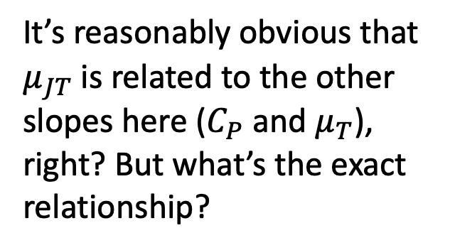
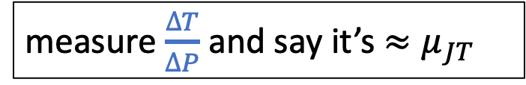



Today: The Adiabatic Joule-Thomson experiment
$$C_{P}$$
It’s reasonably obvious that $μ_{JT}$ is related to the other slopes here ($C_{P}$ and $μ_{T}$), right? But what’s the exact relationship?
$$μ_{T}$$
$$∆P$$
$$∆T$$
measure $\frac{∆T}{∆P}$ and say it’s ${≈μ}_{JT}$

Slide 3
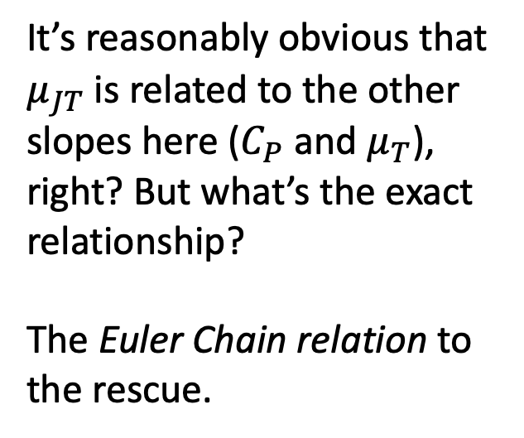
Today: The Adiabatic Joule-Thomson experiment
$$C_{P}$$
It’s reasonably obvious that $μ_{JT}$ is related to the other slopes here ($C_{P}$ and $μ_{T}$), right? But what’s the exact relationship?
The Euler Chain relation to the rescue.
$$μ_{T}$$
$$∆P$$
$$∆T$$
measure $\frac{∆T}{∆P}$ and say it’s ${≈μ}_{JT}$

Slide 4




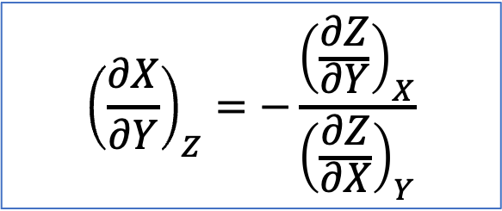
The Euler Chain Relation
The Euler Chain Relation connects slopes to each other.
$${\left(\frac{∂X}{∂Y}\right)}_{Z}=−\frac{{\left(\frac{∂Z}{∂Y}\right)}_{X}}{{\left(\frac{∂Z}{∂X}\right)}_{Y}}$$
Example: ${\left(\frac{∂P}{∂T}\right)}_{V}=−\frac{{\left(\frac{∂V}{∂T}\right)}_{P}}{{\left(\frac{∂V}{∂P}\right)}_{T}}$
Example: ${\left(\frac{∂V}{∂T}\right)}_{P}=−\frac{{\left(\frac{∂P}{∂T}\right)}_{V}}{{\left(\frac{∂P}{∂V}\right)}_{T}}$
Example: ${μ_{JT}≈\left(\frac{∂T}{∂P}\right)}_{H}=$

Slide 5
The Euler Chain Relation
The Euler Chain Relation connects slopes to each other.
$${\left(\frac{∂X}{∂Y}\right)}_{Z}=−\frac{{\left(\frac{∂Z}{∂Y}\right)}_{X}}{{\left(\frac{∂Z}{∂X}\right)}_{Y}}$$
Example: ${\left(\frac{∂P}{∂T}\right)}_{V}=−\frac{{\left(\frac{∂V}{∂T}\right)}_{P}}{{\left(\frac{∂V}{∂P}\right)}_{T}}$
Example: ${\left(\frac{∂V}{∂T}\right)}_{P}=−\frac{{\left(\frac{∂P}{∂T}\right)}_{V}}{{\left(\frac{∂P}{∂V}\right)}_{T}}$
Example: ${μ_{JT}≈\left(\frac{∂T}{∂P}\right)}_{H}=$

Slide 6
The Euler Chain Relation
The Euler Chain Relation connects slopes to each other.
$${\left(\frac{∂X}{∂Y}\right)}_{Z}=−\frac{{\left(\frac{∂Z}{∂Y}\right)}_{X}}{{\left(\frac{∂Z}{∂X}\right)}_{Y}}$$
Example: ${\left(\frac{∂P}{∂T}\right)}_{V}=−\frac{{\left(\frac{∂V}{∂T}\right)}_{P}}{{\left(\frac{∂V}{∂P}\right)}_{T}}$
Example: ${\left(\frac{∂V}{∂T}\right)}_{P}=−\frac{{\left(\frac{∂P}{∂T}\right)}_{V}}{{\left(\frac{∂P}{∂V}\right)}_{T}}$
Example: ${μ_{JT}≈\left(\frac{∂T}{∂P}\right)}_{H}=$

Slide 7

The Euler Chain Relation
The Euler Chain Relation connects slopes to each other.
$${\left(\frac{∂X}{∂Y}\right)}_{Z}=−\frac{{\left(\frac{∂Z}{∂Y}\right)}_{X}}{{\left(\frac{∂Z}{∂X}\right)}_{Y}}$$
Example: ${\left(\frac{∂P}{∂T}\right)}_{V}=−\frac{{\left(\frac{∂V}{∂T}\right)}_{P}}{{\left(\frac{∂V}{∂P}\right)}_{T}}$
Example: ${\left(\frac{∂V}{∂T}\right)}_{P}=−\frac{{\left(\frac{∂P}{∂T}\right)}_{V}}{{\left(\frac{∂P}{∂V}\right)}_{T}}$
Example: ${μ_{JT}≈\left(\frac{∂T}{∂P}\right)}_{H}=−\frac{{\left(\frac{∂H}{∂P}\right)}_{T}}{{\left(\frac{∂H}{∂T}\right)}_{P}}$

Slide 8

The Euler Chain Relation
The Euler Chain Relation connects slopes to each other.
$${\left(\frac{∂X}{∂Y}\right)}_{Z}=−\frac{{\left(\frac{∂Z}{∂Y}\right)}_{X}}{{\left(\frac{∂Z}{∂X}\right)}_{Y}}$$
Example: ${\left(\frac{∂P}{∂T}\right)}_{V}=−\frac{{\left(\frac{∂V}{∂T}\right)}_{P}}{{\left(\frac{∂V}{∂P}\right)}_{T}}$
Example: ${\left(\frac{∂V}{∂T}\right)}_{P}=−\frac{{\left(\frac{∂P}{∂T}\right)}_{V}}{{\left(\frac{∂P}{∂V}\right)}_{T}}$
Example: ${μ_{JT}≈\left(\frac{∂T}{∂P}\right)}_{H}=−\frac{{\left(\frac{∂H}{∂P}\right)}_{T}}{{\left(\frac{∂H}{∂T}\right)}_{P}}=−\frac{μ_{T}}{C_{P}}$

Slide 9


Using the Euler Chain Relation to get an experimental value of $μ_{T}$ from a Joule-Thomson expt.
The Euler Chain Relation connects slopes to each other.
$${\left(\frac{∂X}{∂Y}\right)}_{Z}=−\frac{{\left(\frac{∂Z}{∂Y}\right)}_{X}}{{\left(\frac{∂Z}{∂X}\right)}_{Y}}$$
Example: ${\left(\frac{∂P}{∂T}\right)}_{V}=−\frac{{\left(\frac{∂V}{∂T}\right)}_{P}}{{\left(\frac{∂V}{∂P}\right)}_{T}}$
Example: ${\left(\frac{∂V}{∂T}\right)}_{P}=−\frac{{\left(\frac{∂P}{∂T}\right)}_{V}}{{\left(\frac{∂P}{∂V}\right)}_{T}}$
Example: ${μ_{JT}=\left(\frac{∂T}{∂P}\right)}_{H}=−\frac{{\left(\frac{∂H}{∂P}\right)}_{T}}{{\left(\frac{∂H}{∂T}\right)}_{P}}=−\frac{μ_{T}}{C_{P}}$
$$⇒μ_{T}=−C_{P}μ_{JT}$$

Slide 10

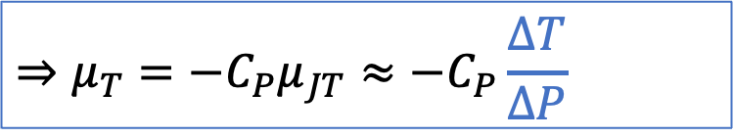
Using the Euler Chain Relation to get an experimental value of $μ_{T}$ from a Joule-Thomson expt.
The Euler Chain Relation connects slopes to each other.
$${\left(\frac{∂X}{∂Y}\right)}_{Z}=−\frac{{\left(\frac{∂Z}{∂Y}\right)}_{X}}{{\left(\frac{∂Z}{∂X}\right)}_{Y}}$$
Example: ${\left(\frac{∂P}{∂T}\right)}_{V}=−\frac{{\left(\frac{∂V}{∂T}\right)}_{P}}{{\left(\frac{∂V}{∂P}\right)}_{T}}$
From our Joule-Thomson experiment
Example: ${\left(\frac{∂V}{∂T}\right)}_{P}=−\frac{{\left(\frac{∂P}{∂T}\right)}_{V}}{{\left(\frac{∂P}{∂V}\right)}_{T}}$
$$∆P$$
$$∆T$$
Example: ${μ_{JT}=\left(\frac{∂T}{∂P}\right)}_{H}=−\frac{{\left(\frac{∂H}{∂P}\right)}_{T}}{{\left(\frac{∂H}{∂T}\right)}_{P}}=−\frac{μ_{T}}{C_{P}}$
$$⇒μ_{T}=−C_{P}μ_{JT}≈−C_{P}\frac{∆T}{∆P}$$

Slide 11
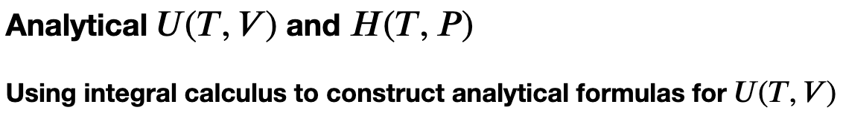



Today: We’ll carry out an adiabatic Joule-Thomson experiment on $CO_{2}$
Measure the temperature change out the throttle, hence $\frac{∆T}{∆P}$, in two groups, ~15 minutes each
$$∆T=T_{2}−T_{1}$$
$$∆P$$
$$∆T$$
The group not doing J-T can work on the CGI

